Slide 1


YOC SERVICE
Khushboo sanwariya
Charanjeet Dhawan
Abhay Saxena
Abhinav Shukla
Sumit Kumar Singh
Group G
© Futurense. All Rights Reserved.

Slide 2

Problem Statement
The client’s startup Your Own Cabs is becoming really popular and it’s growing exponentially. Due to the large scale implementation, the management want to know how the business is performing in its first year of launch.
Hence, we were asked to build a solution to handle all the incoming data and process it in order to make management decision a bit easier.
This project highlights how we can achieve the solution using Big Data technologies for better efficiency.
© Futurense. All Rights Reserved.

Slide 3


Data Sources
Kafka Broker
© Futurense. All Rights Reserved.

Slide 4
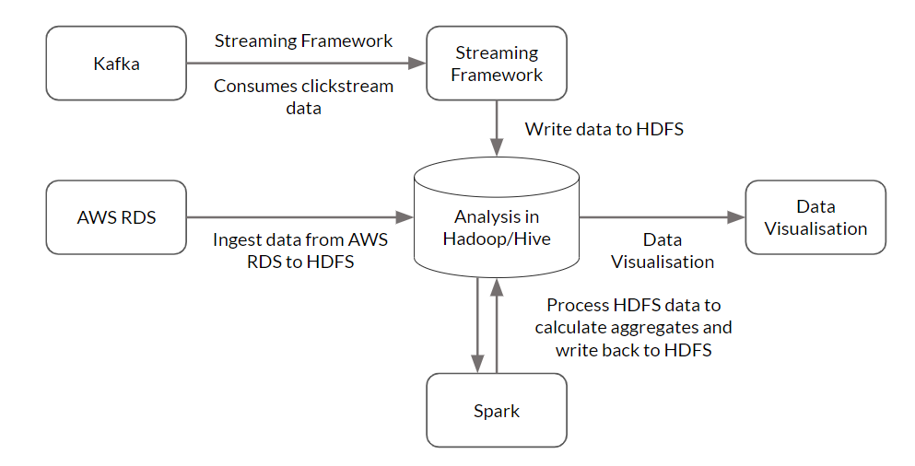
ARCHITECTURE
© Futurense. All Rights Reserved.

Slide 5
BATCH PROCESSING
CLICKSTREAM DATA
PROJECT FLOW
AWS RDS
INGESTION VIA SQOOP
HDFS
PYSPARK
VISUALIZATION
KAFKA BROKER
KAFKA CONSUMER
HDFS
PYSPARK
VISUALIZATION
© Futurense. All Rights Reserved.

Slide 6
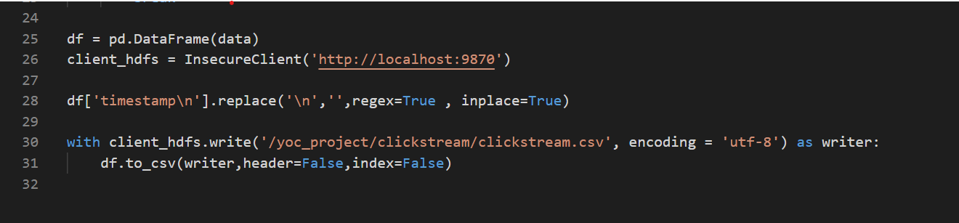
MILESTONE
Click stream data ingestion
© Futurense. All Rights Reserved.

Slide 7
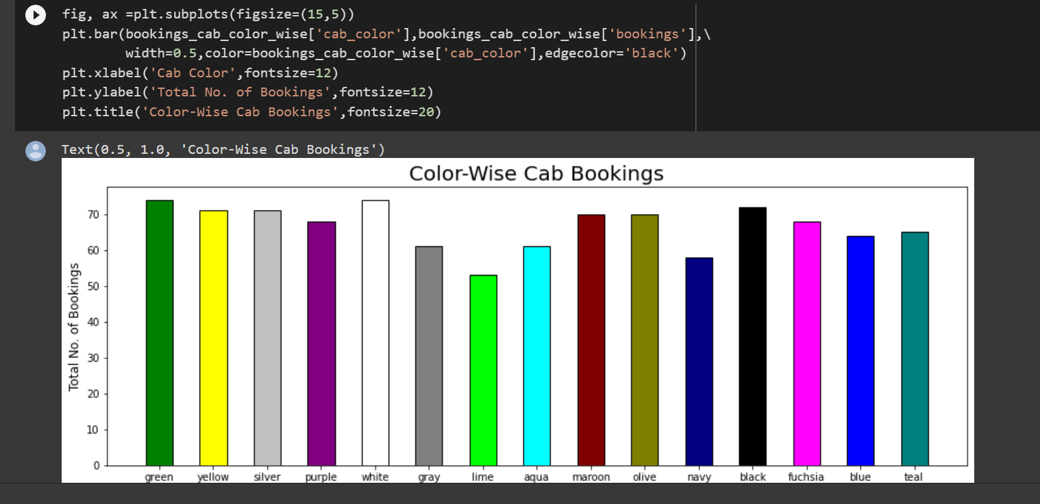
Transformation
Total number of bookings color-wise.
© Futurense. All Rights Reserved.

Slide 8
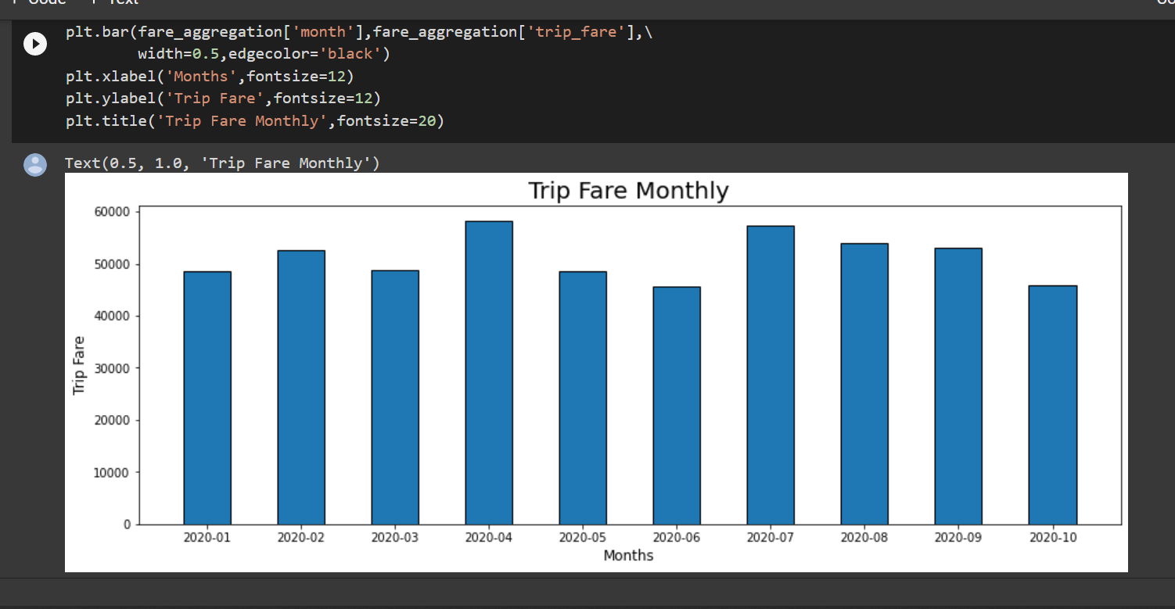
Trip fare Monthly.
© Futurense. All Rights Reserved.

Slide 9
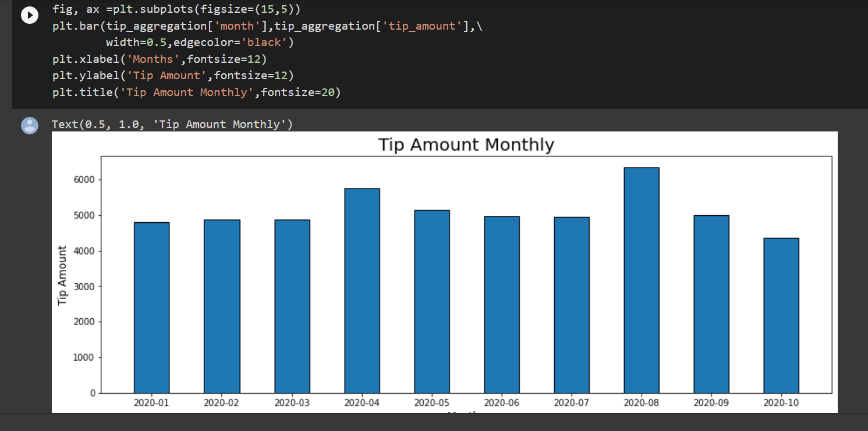
Tip Amount Monthly.
© Futurense. All Rights Reserved.

Slide 10
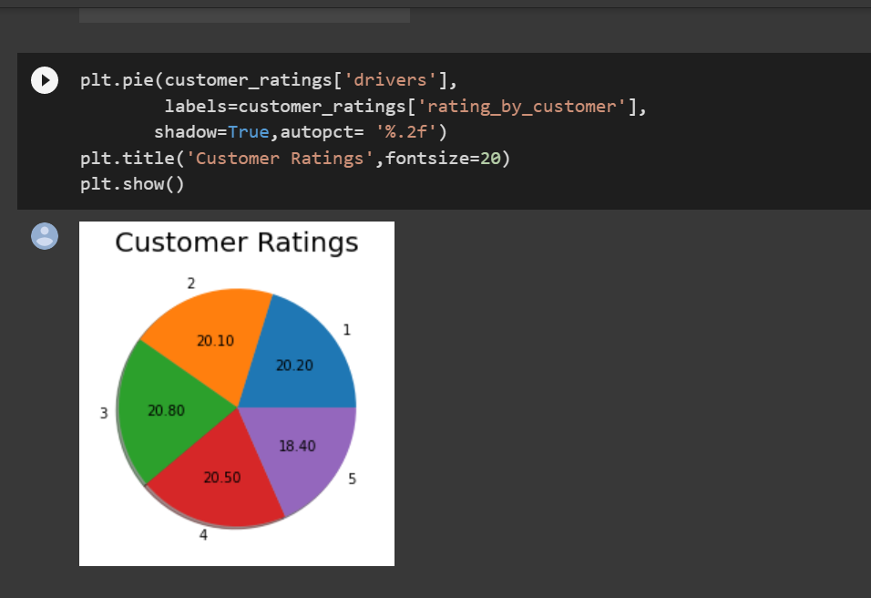
Customer Rating
© Futurense. All Rights Reserved.

Slide 11
POC - Proof Of Concept
The aim of this project is to collect all the Key Performance Indicators in order to make management decisions for exponential growth of the company.
We were provided with two types of data, Booking Data(Batch Data) and Clickstream Data(Real-time Data).
Batch data was stored in AWS RDS which we extracted using sqoop commands and stored it into HDFS. Then, we imported that data into pyspark and did EDA for performing aggregations.
Clickstream data was fetched from kafka broker provided by client using Kafka consumer, saved it in HDFS. Then, it was analysed in Pyspark and used pandas and matplotlib for visualisation.
© Futurense. All Rights Reserved.

Slide 12

THANK YOU
© Futurense. All Rights Reserved.

